Slide 1

PBL presentation for Skills and Competency Evaluation(SCE) SENSORS TECHNOLOGY: (ETOEUA21239C)(SY ILE SEM-I AY 24-25 )
Smart Stick For Blind People
Branch:- CSE(AIML),Div.:- A
By: Group No.:- AIML2
Roll No. | G.R. No. | Name of Student | Contact number
291022 | 22310510 | Gayatri Pratap Pawar | 8766413909
291033 | 22311053 | Shreya Sarjerao Varute | 9209031880
Name of instructor: Prof. Vishal Ambhore
Department of Electronics and Telecommunication Engineering
BRACT’S, Vishwakarma Institute of Information Technology, Pune-48
(An Autonomous Institute affiliated to Savitribai Phule Pune University) (NBA and NAAC accredited, ISO 9001:2015 certified)
1

Slide 2
OUTLINE
AIM
OBJECTIVES
HARDWARE MATERIALS ARE REQUIRED AND SPECIFICATIONS
DESIGN (BLOCK DIAGRAM)
WORKING DESCRIPTION
ALGORITHM/FLOWCHART
PROGRAM IMPLEMENTATION
HARDWARE IMPLEMENTATION
RESULTS AND CONCLUSION
REFERENCES
TITLE OF PAPER IMPLEMENTED USING PBL

Slide 3
AIM
To design and implement a Smart Stick equipped with obstacle detection, auditory, and vibrational feedback, aimed at enhancing the mobility and safety of visually impaired individuals.
The project will utilize ultrasonic sensors for detecting obstacles and provide real-time feedback through vibration and sound alerts..

Slide 4
OBJECTIVES
Obstacle Detection: Implement a system that accurately detects obstacles in the path of visually impaired individuals.
Feedback Mechanism: Provide real-time feedback through auditory and vibrational signals for obstacle proximity.
User-Friendly Interface: Design an intuitive and ergonomic device that is lightweight, portable, and easy to use.
Power Efficiency: Ensure the system is energy-efficient, with a long-lasting rechargeable battery.
Testing and Validation: Evaluate the device in real-world environments and gather feedback from users.

Slide 5
HARDWARE MATERIAL REQUIRED AND SPECIFICATIONS
Sensors:
Type: HC-SR04
Specification: Range of 2 cm to 400 cm, detection angle of 15°
Microcontroller:
Model: Arduino Uno (ATmega328P)
Specification: 32 KB Flash memory, 2 KB SRAM, 16 MHz clock speed
3.Audio Output:
Type: Mini speaker or piezo buzzer
Specification: 3V to 5V operating voltage
4.Battery:
Type: Rechargeable Li-ion battery
Specification: 3.7V, 2200mAh
5.Charging Circuit:
Type: USB-C module
Specification: 5V charging input(Laptop)
6.Other Components:
wires
PCB for circuit integration

Slide 6
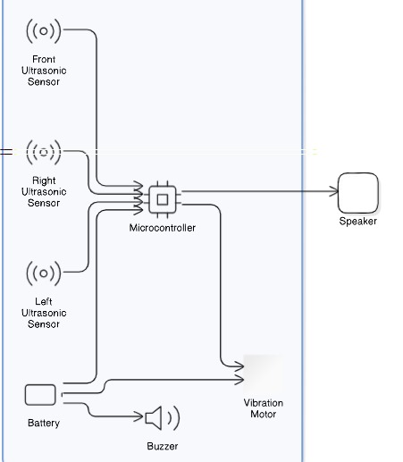
DESIGN (BLOCK DIAGRAM)

Slide 7
WORKING DESCRIPTION
The ultrasonic sensor sends out sound waves to detect obstacles within a defined range.
The sound waves reflect off the obstacles, and the sensor calculates the distance based on the time taken for the echo to return.
The microcontroller processes the data and triggers the appropriate feedback (vibrational or auditory) based on the distance of the obstacle.
Close obstacle: Stronger vibration and continuous beeping.
Far obstacle: Weak vibration and intermittent beeping.
The system is powered by a rechargeable battery and includes a battery level indicator for user convenience.
Department of Electronics and Telecommunication Engineering, VIIT, Pune-48
8

Slide 8
ALGORITHM
Initialize Constants and Variables:
Define the pins for ultrasonic sensors and buzzer.
Declare variables to hold current and previous distances for each sensor.
Set threshold values for motion detection and proximity alerts.
Setup Function:
Initialize serial communication for debugging.
Set the sensor pins as INPUT or OUTPUT.
Initialize the buzzer pin and ensure it is off.
Main Loop:
Distance Measurement:
Call getDistance() function for each sensor (front, left, right) to read current distances.
Print the current distances to the Serial Monitor.
Proximity Alert:
Check if any of the current distances are less than or equal to the proximity threshold.
If true, activate the buzzer.
If false, deactivate the buzzer.
8

Slide 9
ALGORITHM
Vehicle Approach Detection:
Call detectVehicleApproach() function to determine which direction vehicles are approaching.
Update Previous Distances:
Store current distances into previous distance variables for the next loop iteration.
Delay:
Introduce a sdelay before repeating the loop.
Get Distance Function (getDistance()):
Clear the trigPin to ensure a clean tart.
Trigger the ultrasonic sensor by sending a high pulse for 10 microseconds.
Measure the time taken for the echo to return.
Calculate the distance based on the duration of the echo.
Handle cases where no object is detected within range (timeout).
Vehicle Approach Detection Function (detectVehicleApproach()):
Determine if an object is approaching from the front, left, or right based on the current distances.
Print appropriate messages to the Serial Monitor indicating from where the vehicle is approaching or if no vehicle is approaching.
9

Slide 10
PROGRAM IMPLEMENTATION
// Define pins for front ultrasonic sensor (used for both motion detection and proximity)
const int trigFront = 2;
const int echoFront = 3;
// Define pins for left ultrasonic sensor (motion and proximity)
const int trigLeft = 4;
const int echoLeft = 5;
// Define pins for right ultrasonic sensor (motion and proximity)
const int trigRight = 6;
const int echoRight = 7;
// Define pin for buzzer
const int buzzerPin = 9;
// Variables to store the previous and current distances for motion detection
long previousDistanceFront = 0;
long currentDistanceFront = 0;
long previousDistanceLeft = 0;
long currentDistanceLeft = 0;
long previousDistanceRight = 0;
long currentDistanceRight = 0;
const int motionThreshold = 5; // Threshold for detecting relative motion in cm
const int proximityThreshold = 30; // Updated threshold for buzzer activation at 30 cm
void setup() {
// Initialize serial communication for debugging Serial.begin(9600);
// Setup ultrasonic sensor pins
pinMode(trigFront, OUTPUT);
pinMode(echoFront, INPUT);
pinMode(trigLeft, OUTPUT);
pinMode(echoLeft, INPUT);
pinMode(trigRight, OUTPUT);
pinMode(echoRight, INPUT);
// Setup buzzer pin
pinMode(buzzerPin, OUTPUT);
// Ensure buzzer is off initially
digitalWrite(buzzerPin, LOW);
}
void loop() {
// Read distances from all sensors
currentDistanceFront = getDistance(trigFront, echoFront); currentDistanceLeft = getDistance(trigLeft, echoLeft); currentDistanceRight = getDistance(trigRight, echoRight);
// Print distances to Serial Monitor
Serial.print("Front: "); Serial.print(currentDistanceFront);
Serial.print(" cm | Left: "); Serial.print(currentDistanceLeft);
Serial.print(" cm | Right: "); Serial.println(currentDistanceRight);
// Check for proximity alert (any sensor within threshold) if (currentDistanceFront <= proximityThreshold || currentDistanceLeft <= proximityThreshold || currentDistanceRight <= proximityThreshold) {
// Activate buzzer
digitalWrite(buzzerPin, HIGH);
} else {
// Deactivate buzzer
digitalWrite(buzzerPin, LOW);
}
10

Slide 11
PROGRAM IMPLEMENTATION
// Check for approaching vehicles and print the appropriate message detectVehicleApproach();
// Update previous distances for the next loop
previousDistanceFront = currentDistanceFront;
previousDistanceLeft = currentDistanceLeft;
previousDistanceRight = currentDistanceRight;
// Small delay before the next loop
delay(1000);
}
// Function to measure the distance using the HC-SR04 sensor
long getDistance(int trigPin, int echoPin) {
// Clear the trigPin
digitalWrite(trigPin, LOW);
delayMicroseconds(2);
// Trigger the sensor by sending a HIGH pulse of 10 microseconds
digitalWrite(trigPin, HIGH);
delayMicroseconds(10);
digitalWrite(trigPin, LOW);
// Read the time it takes for the echo to return
long duration = pulseIn(echoPin, HIGH, 30000); // Timeout after 30ms
// Calculate the distance in centimeters
long distance = (duration * 0.034) / 2;
// Handle timeout
if (duration == 0) {
distance = -1; // Indicate no object detected within range }
return distance;
}
// Function to detect which direction a vehicle is approaching from
void detectVehicleApproach() {
bool frontApproaching = currentDistanceFront <= proximityThreshold;
bool leftApproaching = currentDistanceLeft <= proximityThreshold;
bool rightApproaching = currentDistanceRight <= proximityThreshold;
// Determine direction based on proximity readings
if (frontApproaching && leftApproaching && rightApproaching) { Serial.println("Vehicle approaching from front, left, and right");
} else if (frontApproaching && leftApproaching) { Serial.println("Vehicle approaching from front and left");
} else if (frontApproaching && rightApproaching) { Serial.println("Vehicle approaching from front and right");
} else if (leftApproaching && rightApproaching) { Serial.println("Vehicle approaching from left and right");
} else if (frontApproaching) { Serial.println("Vehicle approaching from front"); } else if (leftApproaching) { Serial.println("Vehicle approaching from left");
} else if (rightApproaching) { Serial.println("Vehicle approaching from right"); } else { Serial.println("No vehicle approaching");
}
}
11

Slide 12
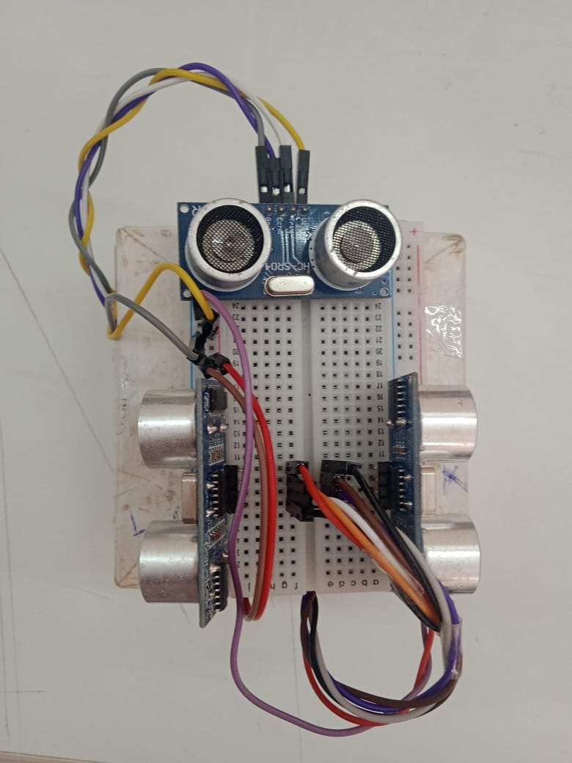
HARDWARE IMPLEMENTATION:
Ultrasonic sensors with Arduino
12

Slide 13
RESULTS AND CONCLUSION
Results:
The Smart Stick successfully detected obstacles and provided real-time feedback to the user through auditory and vibrational signals.
The system performed effectively within a detection range of 1 meter.
Battery life was sufficient for extended usage, and the feedback system was reported as clear and helpful by testers.
Conclusion: The smart stick provided visually impaired users with an enhanced sense of spatial awareness and independence, improving their mobility and safety in real-world environments.
13

Slide 14
REFERENCES:
Paper Reference: Design of a Sound Activated Switch
[Link](https://www.sciencedirect.com/science/article/pii/S1877050915009325)
2.Paper Reference: Introduction to Digital Circuits and CD4017 Applications
[Link](https://www.researchgate.net/publication/322197715_Application_of_CD4017_&_555_Timer)
3. Paper Reference: Clap Switch Design Using Microcontroller
[Link](https://www.ijrra.net/PublishedPaper/14-10-2015/8.pdf)
4.Paper Reference: Smart Home Control System Based on Sound Recognition
[Link](https://www.sciencedirect.com/science/article/pii/S187705091400645X)
5.Paper Reference: Development of Smart Clap Switch with IoT Integration
[Link](https://ieeexplore.ieee.org/document/8608789)
15

Slide 15
TITLE OF PAPER IMPLEMENTED USING PBL
“Design and Implementation of Smart Stick for Detecting Obstacles using Ultrasonic Sensors”
16

Slide 16
Thank You

